Slide 1
Sentinel Program 2023
Gerald Lim Wee Koon
Keith Sim Jun Jie
Phyllis Poh
Chua Zhe Xuan
UNCLASSIFIED
Notes:
Good afternoon, welcome to DSO’s Cyber Data Analysis Challenge.

Slide 2




About Us
Team DSO
Gerald
Keith
Phyllis
Zhe Xuan
Notes:
Today’s lesson will be conducted by myself and my lovely colleagues, keith, phyllis and zhe xuan.

Slide 3
Contents
01
04
Window Event Logs
Learning
Objectives
02
05
Threat Hunting
with Python
Machine Learning
VS
Heuristics
Case Studies
03
06
SPLUNK (OPTIONAL)
Notes:
I will briefly go through the Learning Objectives for today and then give you a quick run through on the differences between the machine learning and heuristical approach.
I will also go through a case study with you to show you how the attack strings would end up in the server logs and what we might do to catch the attacker.
In addition, I will be going through briefly on the Windows Event Logs, followed by a 40 minutes hands on cyber data analysis with python.
If time permits, we will also be doing some hands-on with splunk.

Slide 4
Learning Objectives
Learn different methods for Heuristics and Machine Learning approaches.
Learning how to convert evtx files into easily digestable csv, json and xml formats.
Learning how to filter and manipulate data using a pandas data frame to do threat hunting.
(OPTIONAL) Learn how to use SPLUNK and commands use to gather statistics
Notes:
The Learning Objectives will be to learn different methods for heuristics and machine learning approaches
Learning how to filter and manipulate data in a pandas dataframe for threat hunting
If time permits, I will go through some splunk commands as well.

Slide 5
Data Analytics Approach
Machine Learning VS Heuristics
Machine Learning
Heuristics
Requires a huge dataset for training
Training dataset may be labelled or unlabelled. However, results would be better if labelled
No one-size-fit-all solution:
Neural Networks
Naive Bayes Classifier
Tree-Based Algorithms (Random Forest, Decision Tree, Adaptive-Boosted Tree)
Takes time to do training and fine tuning
Probability scoring
Requires analyst to know existing attack patterns
Rule Based
Binary Signatures
Regex Signatures
Notable Window Events / Sysmon Events
Hit or miss
Notes:
For Machine Learning, we would requires a huge dataset for training.
The training dataset may be labelled or unlabelled. However, results would be better if labelled.
There is also no one-size-fit-all solution:
- Neural Networks
- Naïve Bayes Classifier
- Tree-Based Algorithms (Random Forest, Decision Tree, Adaptive-Boosted Tree)
It takes time to do training and fine tuning
The prediction results are usually based on probability Scoring
For the Heuristical Approach, we would require the analyst to know existing attack patterns
Rule Based
- Binary Signatures
- Regex Signatures
- Notable Window Events / Sysmon Events
It is usually a hit or miss, although you could also do probability scoring

Slide 6
Case Study – Log4j Vulnerability
JNDI (Java Naming and Directory Interface)
Application Programming Interface (API)
Allows distributed applications to look up services in an abstract, resource-independent way.
jndi:ldap//backend.example.com/a
frontend.example.com
backend.example.com
Bindings:
a: ValidateCreds.class
b: GetDatabase.class
c: CheckUserActivity.class
ValidateCreds.class
Notes:
To further understand how we can apply heuristics or machine learning methods, we shall take a look at the Log4J vulnerability which affected all servers that used log4j for logging back in Dec 2021.
It involves the abuse of JNDI lookup. JNDI means Java Naming and Directory Interface which allows distributed applications to look up services in an abstract, resource-independent way.
To illustrate what I have just explained, i am going to present to you 2 servers, one frontend and the other is the backend. The front end requests for resource ‘a’ to the backend. The backend that lookups the request resource to the actual resource name and returns ValidateCreds.class back to the frontend to run. Now, let us look at how an attacker might exploit this API.

Slide 7
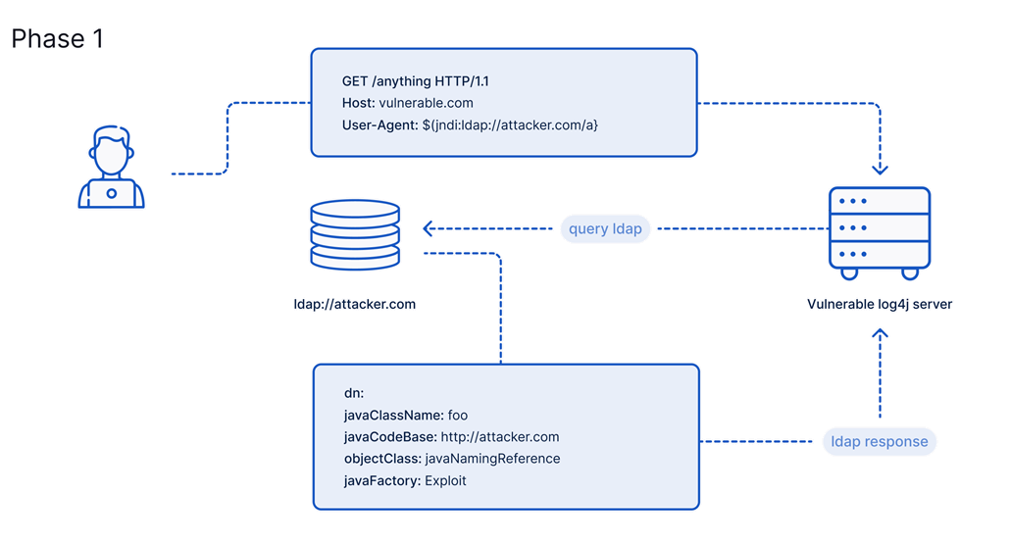
Case Study – Log4j Vulnerability
Notes:
An attacker first sends a malicious jndi lookup request and in this case, the attacker chose to put it in the User-Agent field and sends it to a server that uses the vulnerable log4j jar file.
The server then does a jndi lookup via ldap towards the attacker’s server which will serve a malicious payload / file back to the vulnerable server.

Slide 8
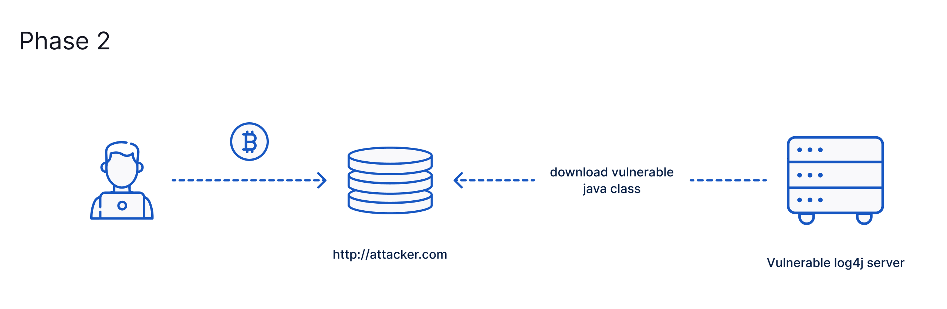
Case Study – Log4j Vulnerability
Notes:
The vulnerable server will download the malicious paylaod and run it.
The payload could be ransomware, a reverse shell or other forms of malware.

Slide 9
Case Study – Log4j Vulnerability
DEMO TIME
Notes:
I am going to show you a quick demo on the log4j attack and let you see how it appears in the vulnerable server logs.
In the top half, we have our vulnerable server whose domain is registered at gofinance.org. Here you can see that we are at a simple user login page.
So as you can see, if we enter some wrong credentials, the Log4j logger prints out the username and if I were to send the jndi request, you can see that it appears in the logs too.
Right now, I am going to carry out my attack for real. To do so, I need to start a nc listener at port 9001 as my malicious payload contains a TCP reverse shell that connects back to my machine at port 9001.
Afterwards, I will just send the same jndi string into the username field and as you can see, on the bottom right, i have received a connection.
If iI do whoami && hostname, you can see that I am actually root and I am currently in gofinance.org’s server.

Slide 10
How do we detect attacker’s activity?
Machine Learning Aproach:
Anomalous IP Addresses?
Anomalous looking JNDI queries?
Popular models for anomaly detection:
Auto Encoder
Isolation Forest
One Class SVM
Heuristics Approach:
YARA rules (based on regex)
Eg. Check for \${jndi:ldap:\/\/.*}. However, there may be false positives as there are legitimate uses of jndi.
Need to account for obfuscated jndi strings such as
$%7Bjndi:
${jndi:${lower:
${base64:JhtqbmRp
Notes:
Let’s say if you were a threat hunter, you could do the following.
From the machine learning perspective, if the log4j logger also contains the ip addresses of clients connecting to the server, you could perhaps find anomalous IP addresses.
In addition, you may also use language modelling techiniques to identify anomalous looking strings.
Here are some popular models for anomaly detection and this list is non-exhaustive.
With regards to the heuristic approach, you could use YARA rules which is based on regex.

Slide 11
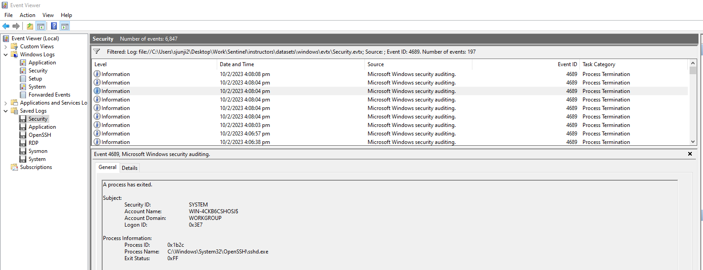
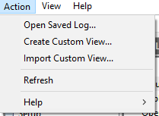
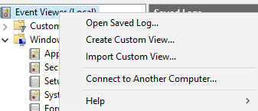
Windows Event Logs
Action > Open Saved Log > [File in datasets\windows\evtx]
Notes:
So, that concludes the difference between heuristic approach and machine learning approach. Now, we will proceed to go briefly into window event logs.
Windows event log is an in-depth record of events related to the system, security, and application stored on a Windows operating system. Event logs can be used to track system and some application issues and forecast future problems.
For those that are unfamiliar with Window Event Logs, you can actually view them with your Event Viewer application if you have a Windows Machine.

Slide 12
Windows Event Logs
Each Event Log has an associated Event ID
https://www.ultimatewindowssecurity.com/securitylog/encyclopedia/default.aspx?i=j
Some useful Event IDs
4611: Trusted Logon
4624: Successful Account Logon
4673: Privilege Service was called
4698: Scheduled Task was created
Notes:
Each windows event log has an associated event ID
For example, some useful event Ids are 4611, 4624, 4673 and 4698 when doing threat hunting. Although useful, sometimes there is alot of noise as well.

Slide 13
Converting EVTX to CSV
EVTX
evtxdump
XML
JSON
CSV
Notes:
As you could see, evtx files are not very friendly to work with.
There are multiple python packages and open source projects out there that tried to parse evtx files to human readable formats.
However, there is one open source project that stands out more to me as it has been the most reliable of all the other tools I have tried.
That will be evtxdump. You can do a quick google search to find the github repo called golang-evtx.
The authors have provided a way for you to convert these evtx files to json and xml.
I have also provided you a script that converts the json objects into a csv file which you will see later in your python notebooks.

Slide 14
Threat Hunting with Python!
Login to jupyter with your given credentials and navigate to your personal folder.
Seats 1-30: https://jupyter5.dart.com.sg
Seats 31-60: https://jupyter2.dart.com.sg
Seats 61-90: https://jupyter4.dart.com.sg
Username: user# (# refers to your seat number)
Password: password#
All EVTX files have been converted to XML, JSON and CSV formats. However, you may choose to rerun evtx_converter.py
Open up your python notebooks and open student_notebooks/1_Context.ipynb
Notes:
Login to jupyter-trainer.darts.com.sg with your given credentials and navigate to your personal folder.
All EVTX files have been converted to XML, JSON and CSV formats. However, you may choose to rerun evtx_converter.py
Open up your python notebooks and open student_notebooks/1_Context.ipynb

Slide 15
Have fun!
If you want a copy of the resource locally, you could go to my github repository to download one for yourself
https://github.com/mathscantor/Sentinel
45 Minutes to play around with the data. Put your answers in Worksheet.ipynb
If you have any questions, or if you run into some errors, please raise your hands and we will go over to help you.
Answers are case sensitive so please bear in mind.
I will do a quick walkthrough of how I get the answers at the end.
For students who managed to solve all 12 questions correctly, please bring down your laptop for instructors to verify and you will receive a prize!
Notes:
If you want a copy of the resource locally, you could go to my github repository to download one for yourself
https://github.com/mathscantor/Sentinel
45 Minutes to play around with the data. Put your answers in Worksheet.ipynb
If you have any questions, or if you run into some errors, please raise your hands and we will go over to help you.
Answers are case sensitive so please bear in mind.
I will do a quick walkthrough of how I get the answers at the end.
For students who managed to solve all 12 questions correctly, please bring down your laptop for instructors to verify and you will receive a prize!

Slide 16
SPLUNK
1. Software for searching, monitoring, and analyzing machine-generated data via a Web-style interface.
2. All data is stored in particular indices.
3. You can think of each index as a box which only store certain kinds of data.
Notes:
1. Software for searching, monitoring, and analyzing machine-generated data via a Web-style interface.
2. All data is stored in particular indices.
3. You can think of each index as a box which only store certain kinds of data.

Slide 17
SPLUNK – Lab Exercise (Reconnaisance)
Context:
Attack happened during August 2017
Company name: Frothly
Company Website: www.froth.ly
Attacks most likely come from East Asia
SplunkServer: https://apthunting.splunk.show
User ID: user001-splk
Password: Splunk.5

Slide 18
SPLUNK – Lab Exercise (Reconnaisance)
Getting a feel of what the our sourcetypes are.
| metadata type=sourcetypes index=botsv2 | FIELDS + sourcetype totalCount | sort - totalCount
sourcetype | totalCount
WinRegistry | 55528820
Perfmon:Process | 49343467
mysql:server:stats | 26926873
mysql:transaction:details | 26756085

Slide 19
SPLUNK – Lab Exercise (Reconnaisance)
Hypothesis:
Attacker might be sloppy and forget to change the user agent field and thus, we may be
able to gather interesting information there.
index=botsv2 sourcetype=stream:http site=www.froth.ly
| stats count by http_user_agent
| sort - count
https://developers.whatismybrowser.com/useragents/parse/
Or you could writer a simple parser and loop through each http_user_agent

Slide 20
SPLUNK – Lab Exercise (Reconnaisance)
What are the different browser types that you saw?
What were the different Operating Systems that you saw?
Did you find any browsers out of the ordinary and why?

Slide 21
SPLUNK – Lab Exercise (Reconnaisance)
Tightening the search:
We want to narrow down on the user agent and see what are its source IPs and destination IPs
index=botsv2 sourcetype=stream:http site=www.froth.ly http_user_agent="Mozilla/5.0 (X11; U; Linux i686; ko-KP; rv: 19.1br) Gecko/20130508 Fedora/1.9.1-2.5.rs3.0 NaenaraBrowser/3.5b4“
| stats count by src_ip dest_ip
src_ip | dest_ip | count
85.203.47.86 | 172.31.6.251 | 51

Slide 22
SPLUNK – Lab Exercise (Reconnaisance)
index=botsv2 sourcetype=stream:http site=www.froth.ly http_user_agent=" Mozilla/5.0 (X11; U; Linux i686; ko-KP; rv: 19.1br) Gecko/20130508 Fedora/1.9.1-2.5.rs3.0 NaenaraBrowser/3.5b4”
| stats count by uri_path
Did you spot any uri_path that stands out? If so, why?

Slide 23
SPLUNK – Lab Exercise (Reconnaisance)
Bonus command:
index=botsv2 sourcetype=stream:http site=www.froth.ly
| anomalydetection method=zscore action=filter pthresh=0.05
| stats count by http_user_agent, uri_path

Slide 24
SPLUNK – Lab Exercise (Reconnaisance)
Bonus Questions:
What is NMAP?
Did the attacker do NMAP?
index=botsv2 src_ip=85.203.47.86
| stats count by dest_ip, dest_port

Slide 25
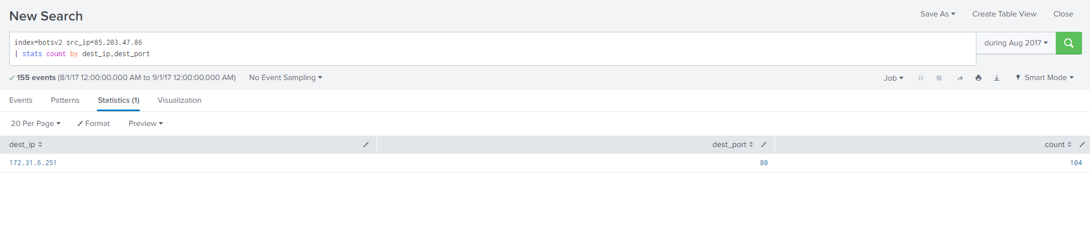
SPLUNK – Lab Exercise (Reconnaisance)

